Slide 1
SILICONE STADIUM
TEAM: HELLO WORLD OR BUST

Slide 2
INTRODUCTION
clay

Slide 3
Subsystems
Logan

Slide 4
Subsystem Communication
Logan/Communication
flask server

Slide 5
DATA FLOW
Clay

Slide 6
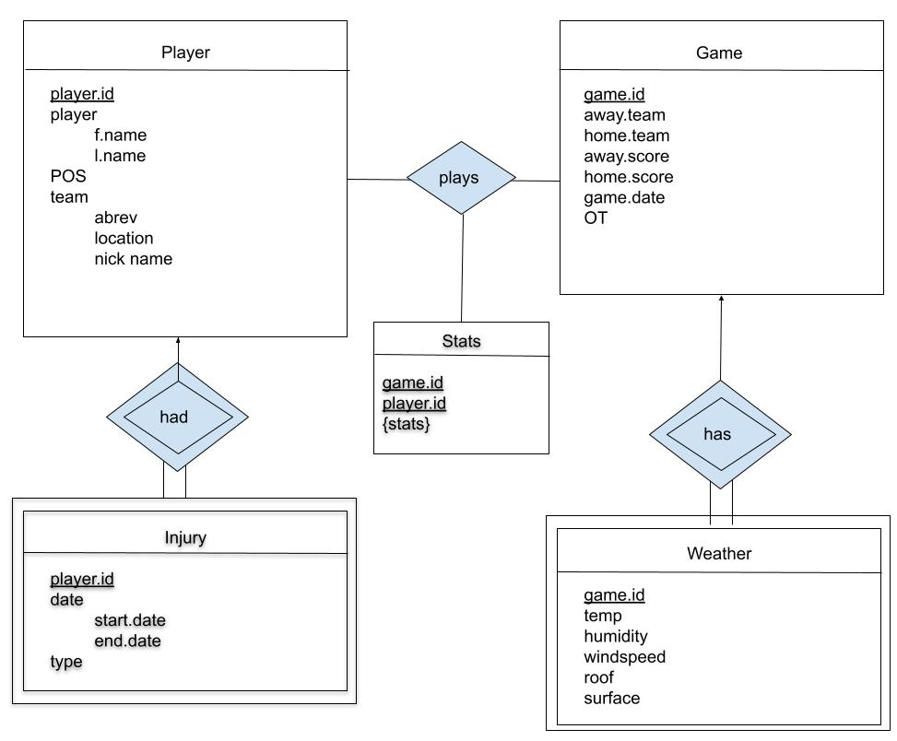
E-R Model
clay

Slide 7
System Model
Logan

Slide 8
System Analysis Perspective
Logan

Slide 9
Tables
Nate

Slide 10
Data Dictionary
Carlos

Slide 11
Algorithm Analysis
Kevin
Notes:
Kevin

